Slide 1
User Guide Filter Press Operation

Slide 2
Contents
4-5. First Time Startup
Description of Operation
Setting Move Positions
Home Screen
Layout
Manual/Auto/Cycle Stop
5. Settings
Conveyors
Speed
Gantry
Position Settings
Filter Plate
Position Settings
Press Settings
Position Settings
Speed
Maintenance/Engineering Mode
Soft Reset
Purge Time
Vac System Reset
Gantry PID Tune Loop
Password Change

Slide 3
Contents
6. Manual Operations
Gantry Manual Controls
Jogging
Conveyors
Filter Plate Manual Controls
Plate Axis On/Off
Press Manual Controls
Maintenance Position
7. Homing Sequence
Trash Collection
8. Run Sequence
Start/Stop Process
9. Errors and Troubleshooting
Error Screen
Error Description
Troubleshooting
10. Other Features

Slide 4
First Time Startup
Operation Description
After initial installation of the filter press. All machine move positions will need to be setup and fine tuned within the HMI.
Not doing so can result in machine damage and inaccurate move positions during a production run. All units are in MM(millimeters) or MM/s millimeters per second.
The following positions need to be setup in sequential order to achieve best results:
Gantry Arm
In Conveyor Pickup Position
Out Conveyor Pickup Position
Gripper 1 Shuttle Position
Gripper 2 Shuttle Position
Gripper 1 Used Product
Gripper 2 Used Product
Gantry Speed in mm/s
Press and Press Lift
Lift up position
Lift down position
Press maintenance position
Press ready position
Press “Pressed” position
Press and Lift Speeds in mm/s
Filter Plate
Filter plate 1st hole position
Filter plate lock pin position
Filter plate feeding speed in mm/s

Slide 5
First Time Startup
Conveyors
Input and output conveyor speeds mm/s

Slide 6
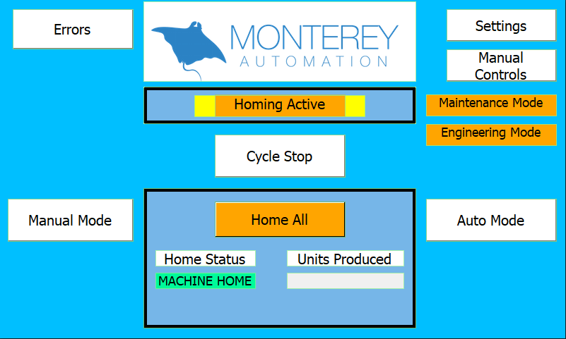
Home Screen Layout
The home screen is presented on machine startup. Below is a description of each item on the home screen. Refer to the Run Sequence for auto operations.
Machine errors screen
Settings screen
Manual controls screen
Machine status indicator
Engineering and maintenance
mode status indicators
Cycle stop/start process button
Home all button
Manual mode button
Auto mode button
Home status indicator
Quantity of units produced

Slide 7
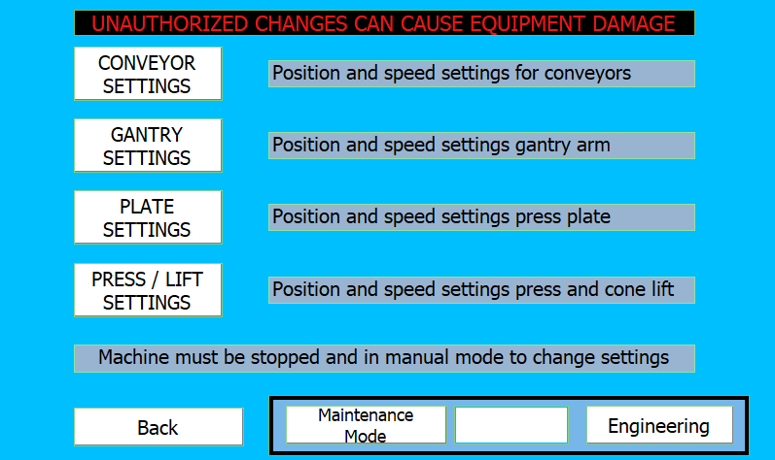
Settings Screen Layout
On the settings screen, each component can be selected individually for adjustment.
Engineering and
maintenance mode buttons

Slide 8
Maintenance / Engineering Mode
Conveyors
Input and output conveyor speeds mm/s

Slide 9
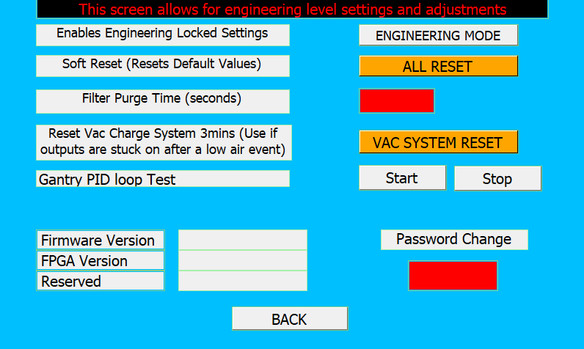

Slide 10
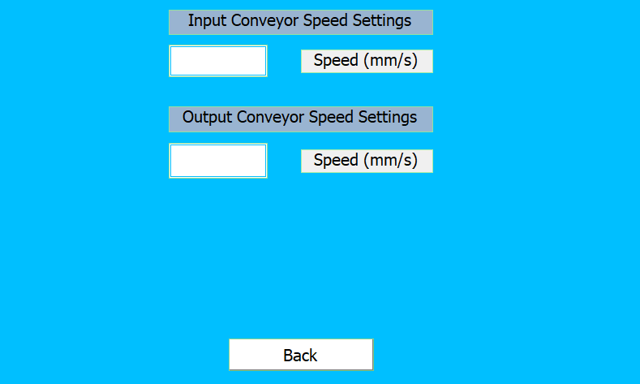

Slide 11
Engineering Mode

Slide 12
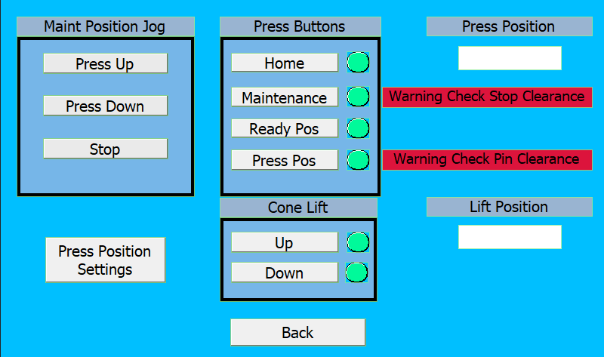

Slide 13
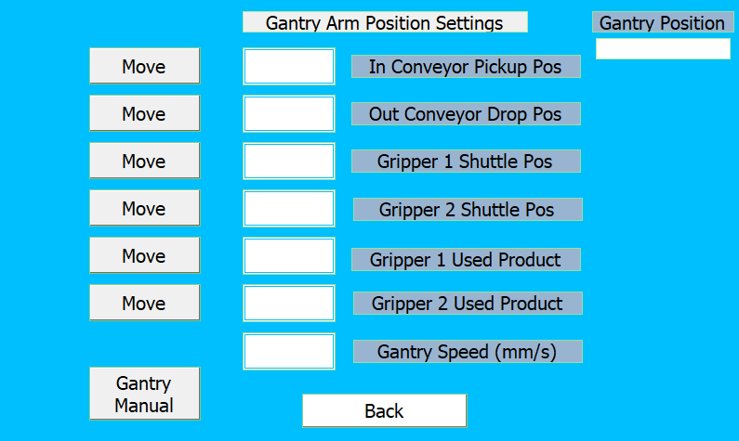

Slide 14
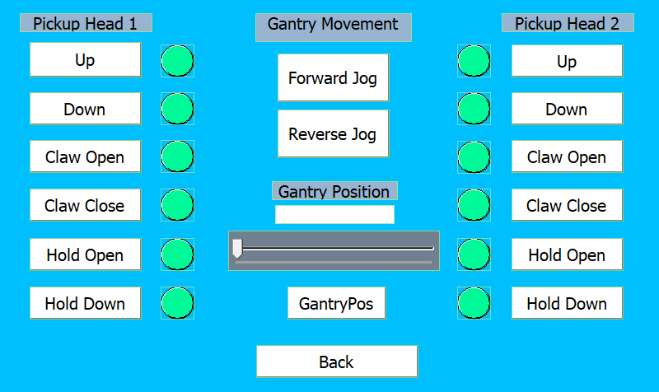

Slide 15
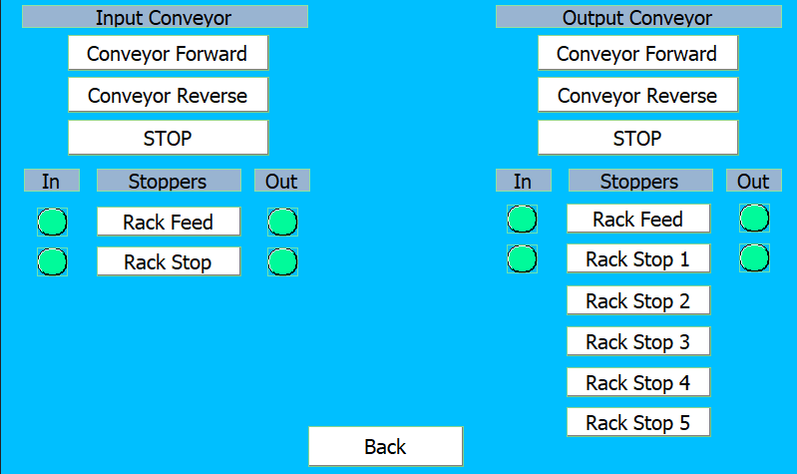

Slide 16
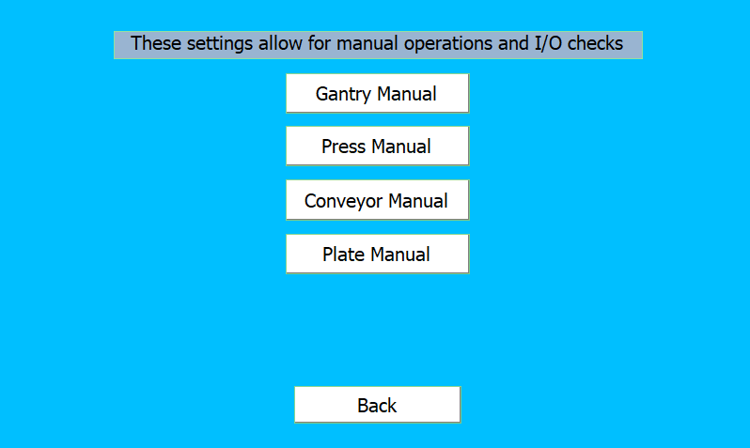

Slide 17
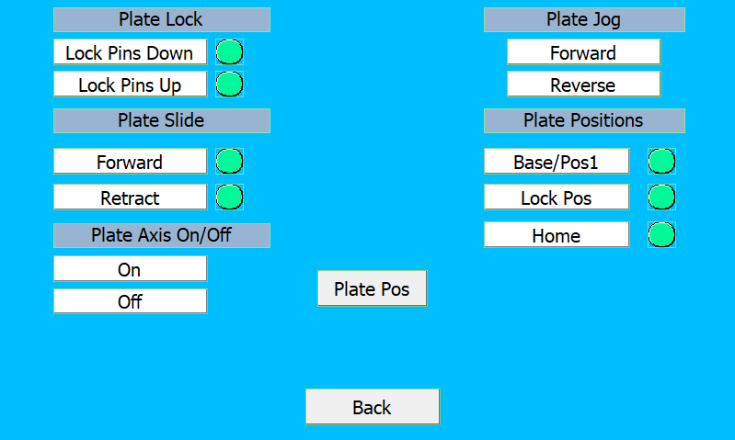

Slide 18
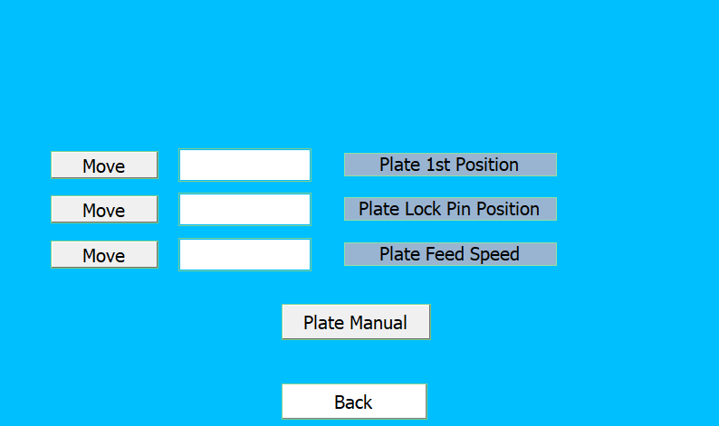

Slide 19
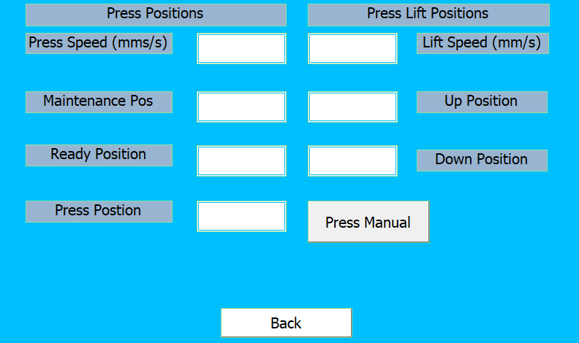

Slide 20
